Slide 1





YOUR LOGO
Education
University
01
Presentation on ebay Website
Project Title: eBay Website Project
Team : Individual Project
Name : Dhana sri sanjana penugonda
Guidence : Vishali sonanis
Date : 08/19/2025
PRESENTATION

Slide 2

Introduction
* eBay is a the one of the e- commerse website
* People use eBay to buy and sell things easily from anywher
* By the using of this website to easily buy and sell many kinds of items online

Slide 3
YOUR LOGO
Responsibilities
* Reserch the eBay website each and every part
* Write test cases for each module
* Write test plan for each module
* Execute testcases
* Write defect report

Slide 4
YOUR LOGO
University
Overview
* eBay is a global online shopping website
* Buyers can search for items and buy them easily
* It will help the user for creating their online store
Presentations are communication tools

Slide 5
YOUR LOGO
Education
University
Modules
Module 1: Login
To check user is able to login into the website using valid credintials
Module 2: Search for product
To verify search button is working or not for customer requirements

Slide 6
YOUR LOGO
Education
University
Module 3: Add to cart
After adding the product into the cart to check product is added or not
Module 4: Delete from the cart
After removing the product from the cart, check if the product is successfully removed or not.

Slide 7
YOUR LOGO
Education
University
Module 5:Change login name
After updating the login name, check if the new name is saved and displayed correctly
Module 6: change current address
After modifying the address verify that the updated address is stored and displayed properly in the user account

Slide 8
YOUR LOGO
Education
University
Module 7:shop by categories
After selecting a category check if the related products are displayed correctly under that category
Module 8: select particular product right click on that product image
After selecting a product right click on its image and check if options like save, copy, view image are working as expected
Graduate Thesis Defense PPT Template
PRESENTATION

Slide 9
YOUR LOGO
Education
University
Module 9:shop by all categories
After selecting the All Categories option check if all product categories are displayed correctly and users can browse through them easily
Module 10: change the language
After updating the language setting verify that the website texts and menus appear in the selected language properly

Slide 10
YOUR LOGO
Education
University
DEFECTS
During test execution some fields do not behave as expected it indicating issues or defects. I have created test plan documented for these problems by creating detailed defect reports for each module.

Slide 11
Education
University
Defect identifier :- eBay_001
Defect summary :- Expected output: After searching the product(lipstick red color) it desplay only red color lipsticks Actual output: It showing another colors also
Test Id :- TC_005
Ø Test case name :- TC_Searching
Ø Module name :- Searching for lipstick
Ø Reproducible :- Search for lipstick (red color)
Ø Severity :- high
Ø Priority :- high
Ø Raised by :- Sanjana
Ø Assigned to :- developer Team lead
Ø Date of assignment :-
Ø Status :- pending
Ø Snap shots :-
Ø Fixed by :- developer
Ø Date of fixing :-

Slide 12
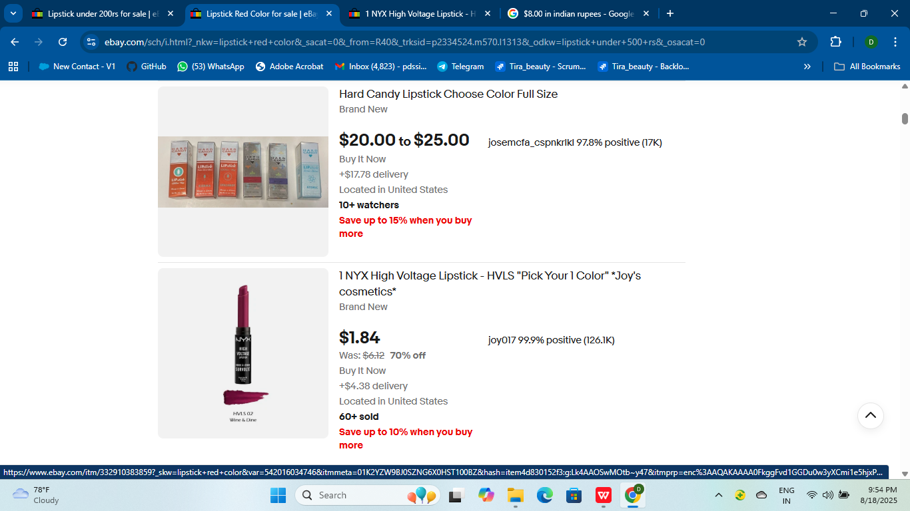
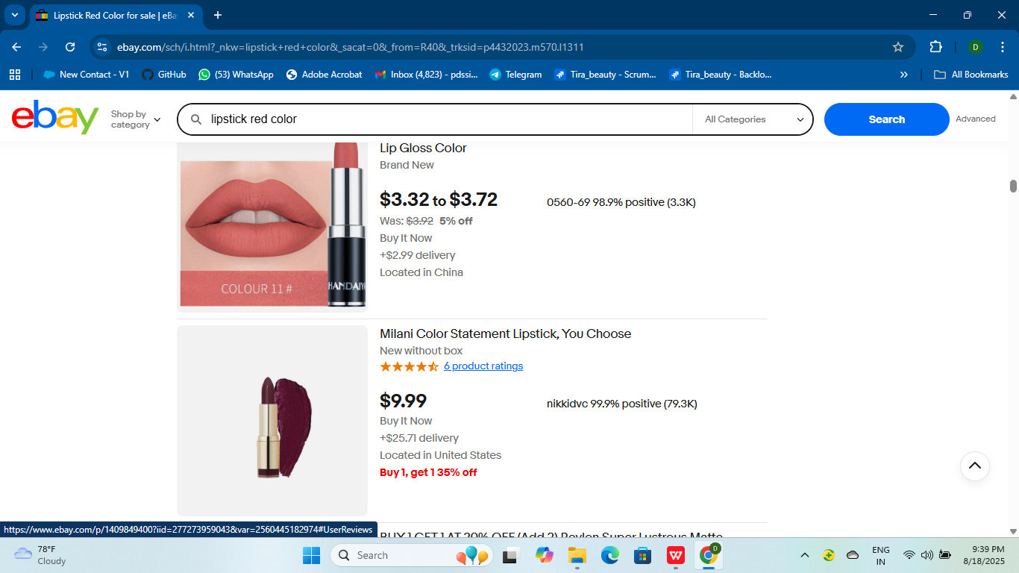
YOUR LOGO
Education
University
Part 3
Achievement display
Graduate Thesis Defense PPT Template
Presentations are communication tools that can be used as speeches, reports, and more.
Graduate Thesis Defense PPT Template
PRESENTATION

Slide 13
Defect identifier :- eBay_002
Defect summary :- I want to pay the money after deliver the product but there is no cash on deliver option
Test Id :- TC_009
Ø Test case name :- TC_COD
Ø Module name :- Cash on delivery
Ø Reproducible :- Select one product and place that order
Ø Severity :- medium
Ø Priority :- high
Ø Raised by :- Sanjana
Ø Assigned to :- developer Team lead
Ø Date of assignment :-
Ø Status :- pending
Ø Snap shots :-
Ø Fixed by :- developer
Ø Date of fixing :-
Education
University

Slide 14
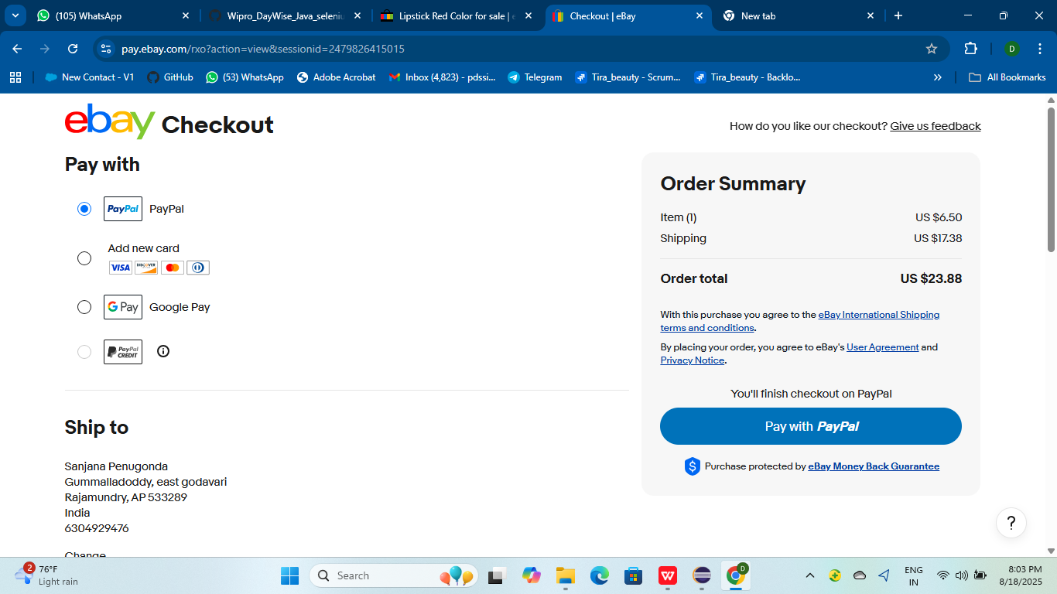


YOUR LOGO
Education
University
Achievement display
Description
Description
28%
Presentations are communication tools that can be used as demonstrations, lectures, speeches, reports, and more.
Presentations are communication tools that can be used as demonstrations, lectures, speeches, reports, and more.
32,495
32,495

Slide 15
YOUR LOGO
Education
University
Challenges
*Balancing all tasks and learning every aspect was a big challenge but it helped improve my skills
*eBay is the one of the biggest e-commerce Application so finding defects are difficult to me
* Making all decisions by alone it is some difficult

Slide 16
YOUR LOGO
Education
University
Experience
* Throgh this project i was learned how testing is important our life
* I had some stage fear, but it went away because we shared screens and explained our projects in class every day
* I got better at writing and running test cases
Graduate Thesis Defense PPT Template
PRESENTATION

Slide 17

YOUR LOGO
Education
University
Thank you
For watching
Vaishali Mam For Guiding me through out the Project.
PRESENTATION

